Slide 1



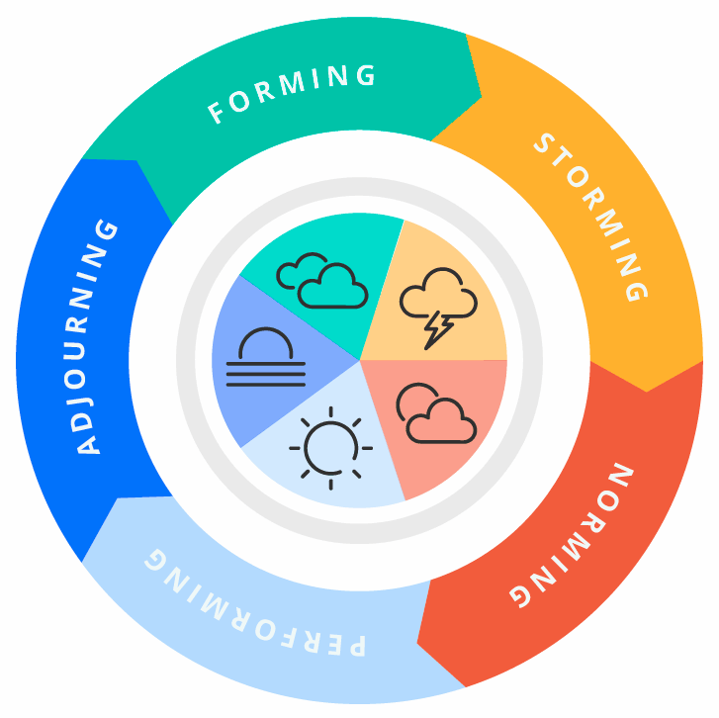


Five Stages of Team Development
Prepared by : Mr. Chivin DOUNG
Co-Founder & GM @ Elevate Solution Partners
Ph.D Candi, Coach, Mentor, Consultant
Date : August 2025

Slide 2

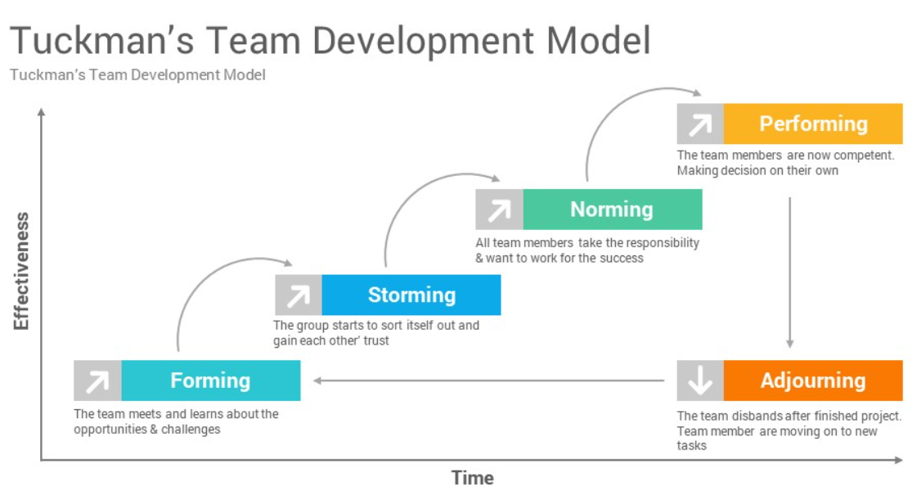

Slide 3
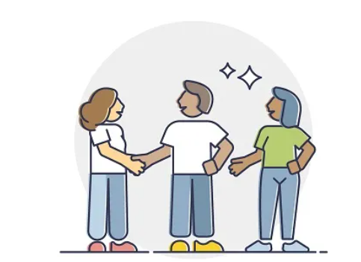
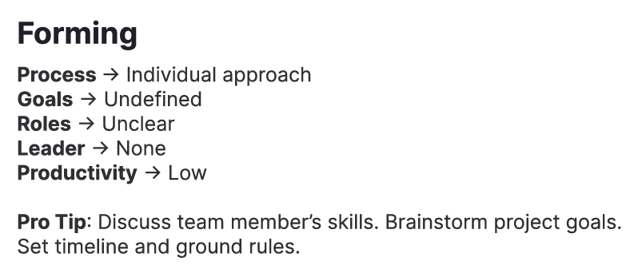
FORMING

Slide 4
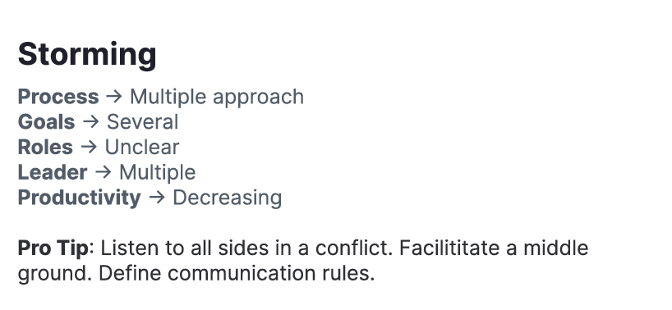
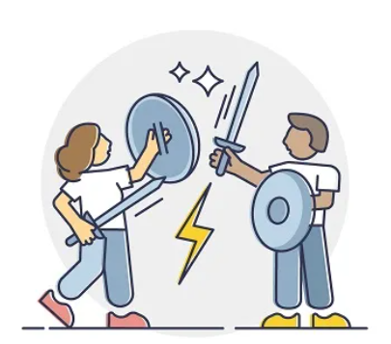
STORMING

Slide 5

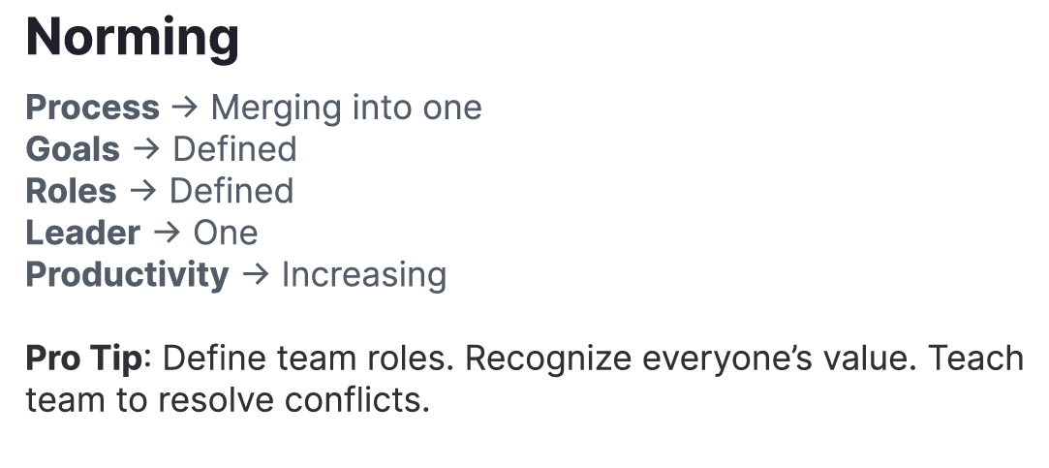
NORMING

Slide 6
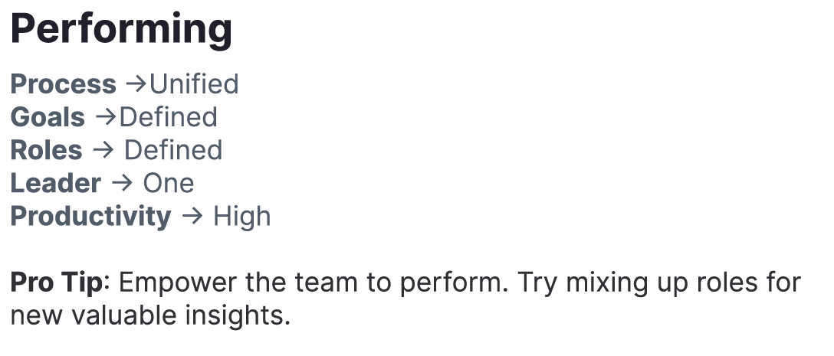

PERFORMING

Slide 7
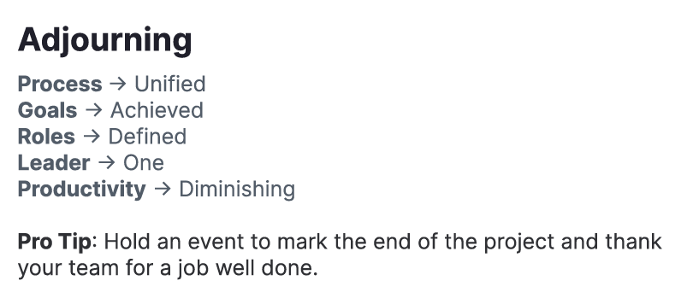

ADJOURNING

Slide 8


THANK YOU?

