Slide 1

The 3 C’s Technique
Building sustainable mechanism that last
Presented by Mr. Chivin DOUNG,
Managing Direct and Lead Trainer

Slide 2

Why Talent Isn’t Enough to Scale Your Business?

Slide 3
The Reason Most SMEs Stall
Most People Don't Fail Because They Lack Talent
Key Points:
They fail because they skip steps.
Talent gets you in the game; the Formula keeps you in it.

Slide 4
Phase 1 – CLARITY (The Compass)
Clarity Turns Desire into Direction
Key Points:
Vague goals produce vague effort.
If you can’t define it, you can’t delegate it.
Example:
Vague: "I want to be the best shop in town.“ => "I want 80% of my customers to return within 30 days.“
“I want to grow” => “In 12 months, this shop must make USD 3,000 net profit per month without me working daily”

Slide 5
The Clarity Audit
Three Questions for Every Owner
What am I actually building? (A job for yourself or a scalable asset?)
What does “done” look like? (How do we know we won today?)
What am I willing to trade? (Are you trading "control" for "growth"?)

Slide 6
Phase 2: COURAGE (The Catalyst)
Courage is Choosing Discomfort over Delay
Key Points:
Move before confidence shows up.
Progress over Perfection.
Example:
The courage to fire a "toxic" high-performer or a family member who doesn't fit the culture.

Slide 7
The "Quiet" Decisions
Courage Isn't Always Loud
It’s the decision to invest in a system when cash is tight.
It’s the decision to say "No" to a client who doesn't fit your niche.
It’s deciding to lead, not just "do."

Slide 8
Phase 3 – CONSISTENCY (The Closer)
Momentum Rewards Repetition, Not Motivation
Key Points:
Consistency is boring—that's why it works.
Small daily actions > Intense occasional effort.
Example:
A restaurant that does a 10-minute "quality check" every single morning vs. one that only fixes things when a customer complains.

Slide 9
Why We Quit
The "Boring" Trap
We don't quit because it's hard; we quit because we don't see the result immediately.
The Law of the Harvest: You don't plant today and eat tomorrow.

Slide 10
When the System Collapses
Missing Piece | Result
No Clarity | You are running fast in the wrong direction.
No Courage | You have a great plan that never leaves your desk.
No Consistency | You are a "Flash in the Pan"—successful today, gone tomorrow.

Slide 11
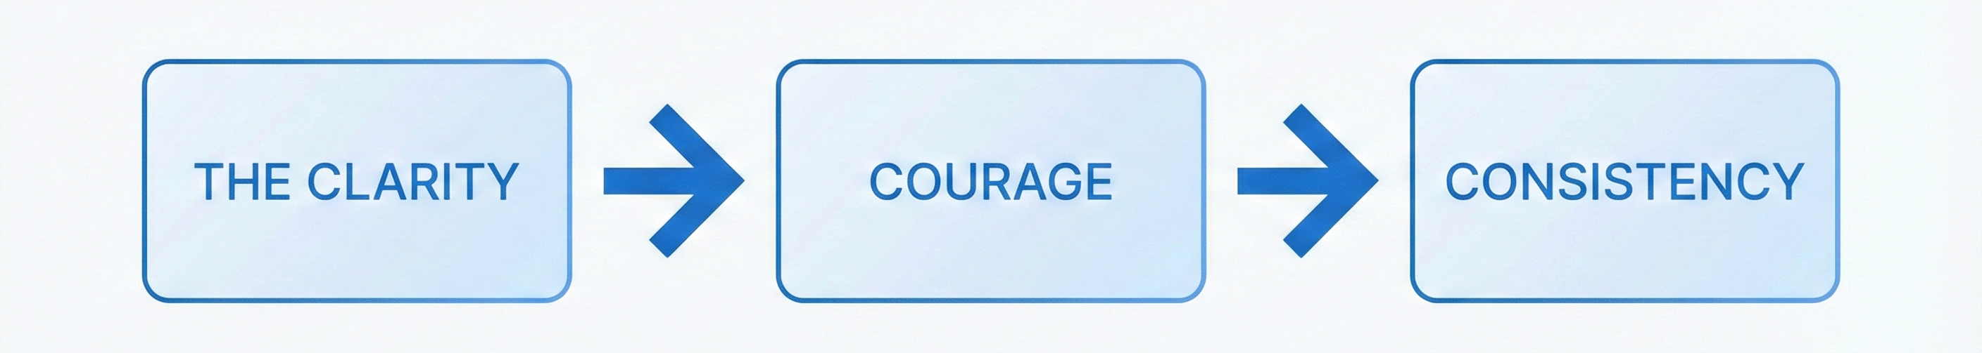
Which is Your Weak Link?
Clarity gives you direction.
Courage gets you started.
Consistency finishes the job.

Slide 13

Thank You

