Slide 1
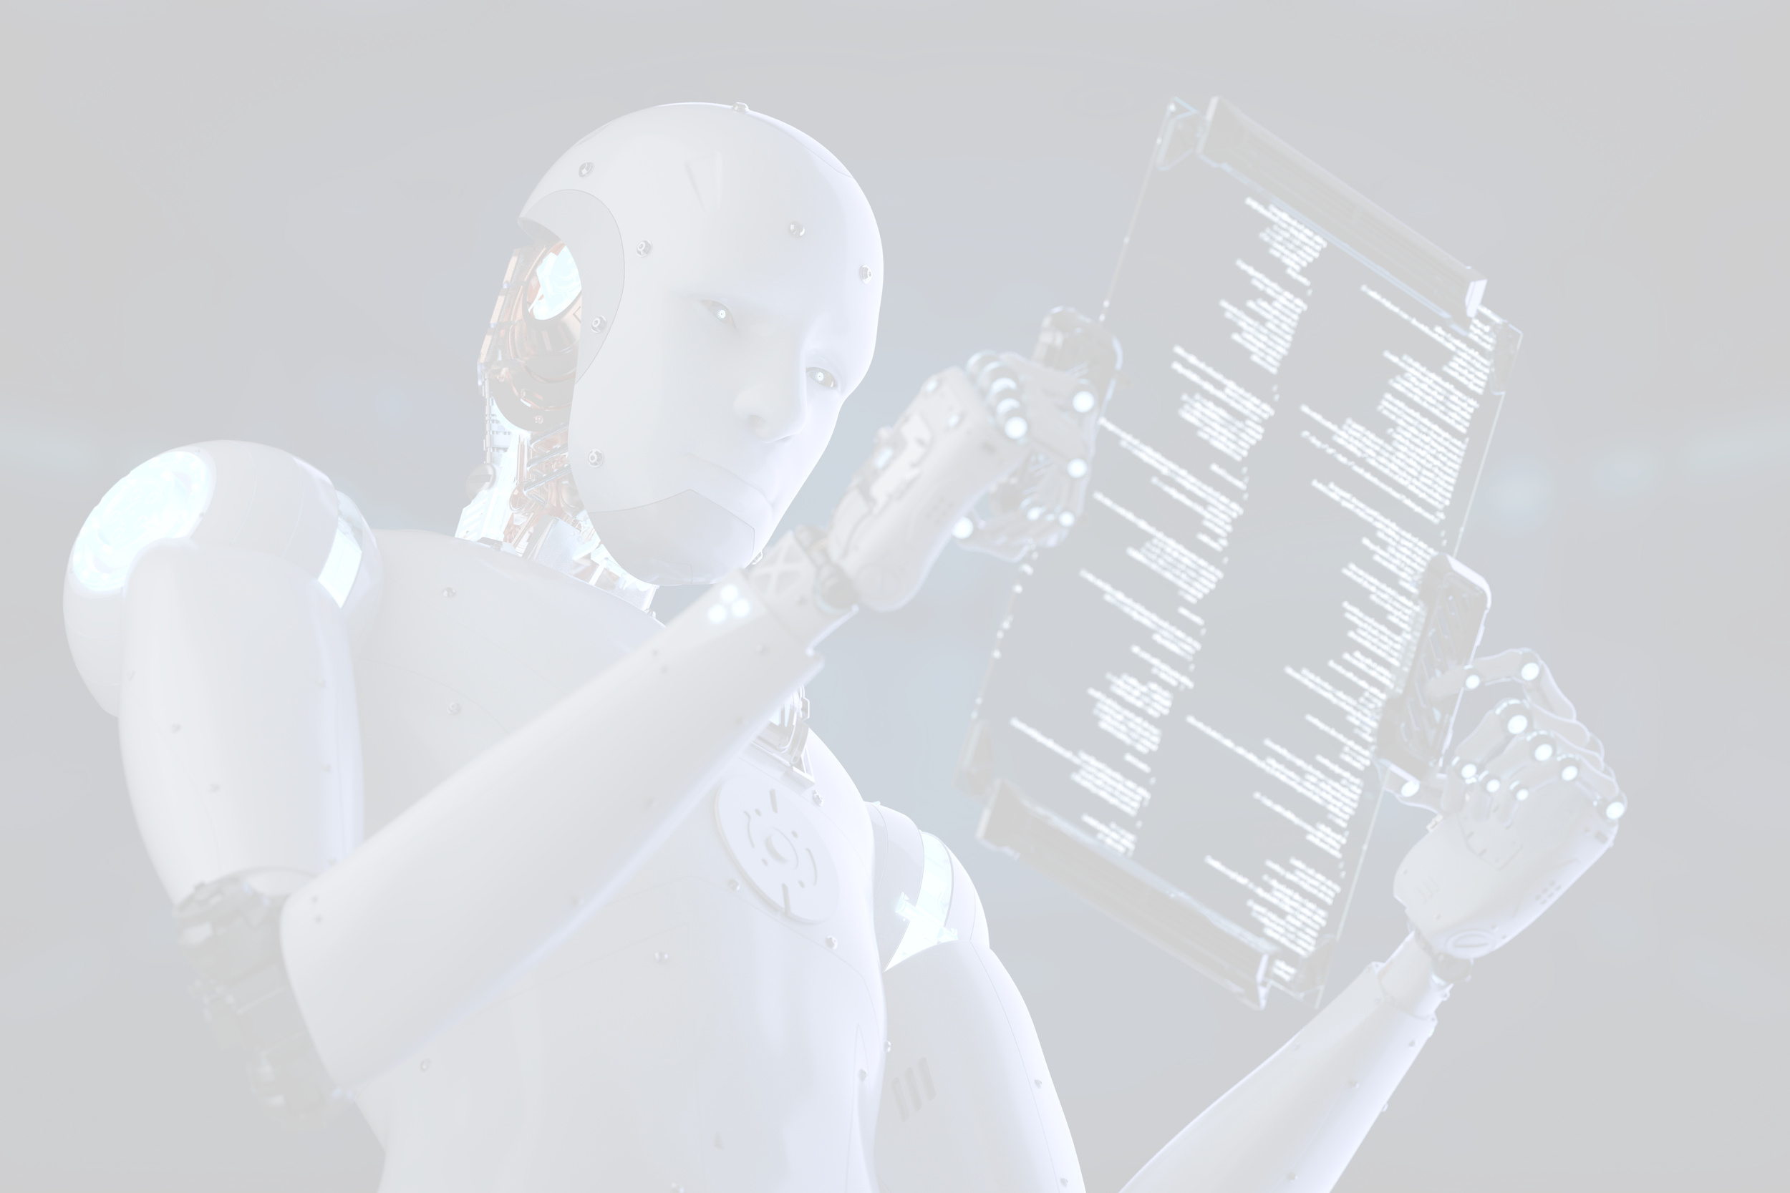
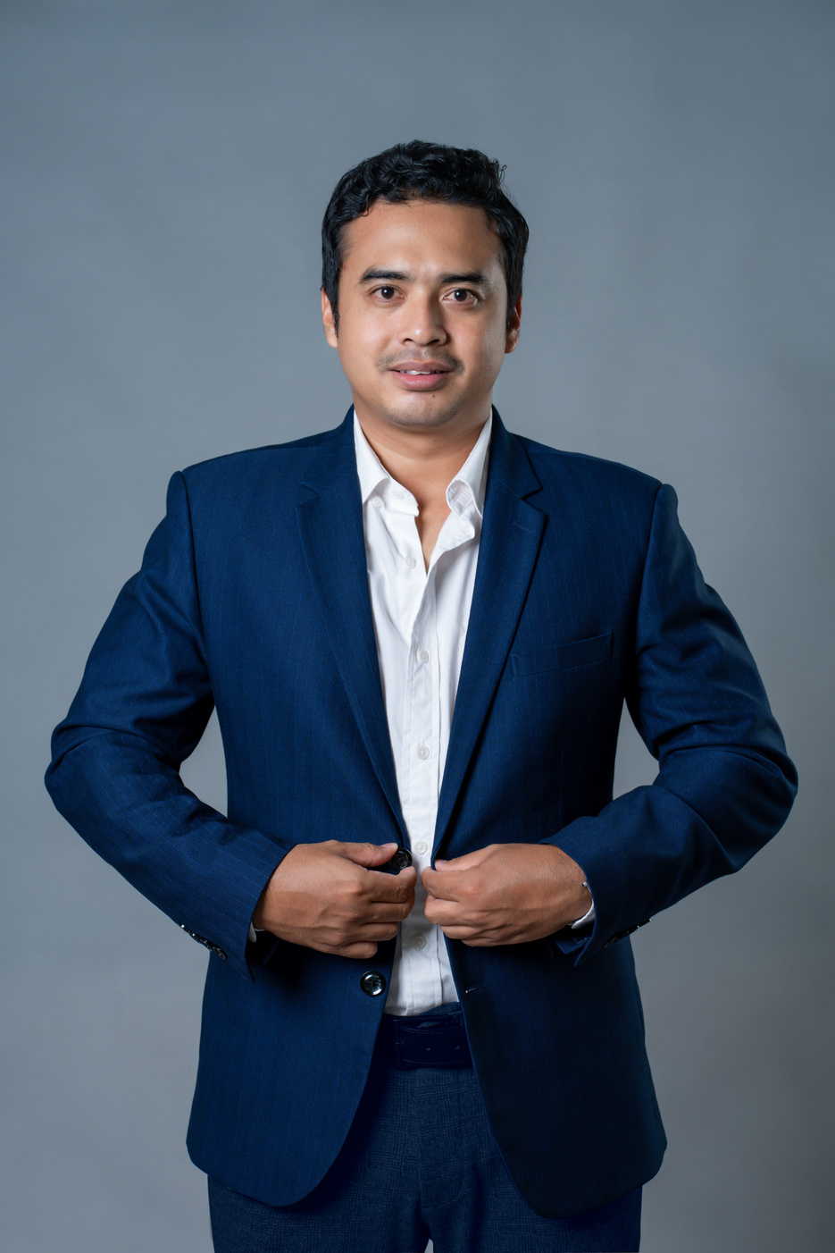
EDUCATIONs:
Doctor of Philosophy (Candidate) - Ph.D of Enterprise at Swiss School of Business Research
Master of International Business
Bachelor of Economic Informatic
Certified Cooperate Trainer for Decathlon Int
Certified Business Development Facilitator
Certified Life Coach and Business Coach.
18+ years experienced in Business Development Management, International Business Management & Trading, Operational Excellence, Project Manager and Retails experience with International Cooperate Companies.
International Profile and Professionalism through training and working experience with total of 11 countries included France, ITaly, Belgium, Switzerland, China, and 7 in Asean.
Managerial and Leadership Experience:
  Entrepreneur
  Adjunct Professor at IMU University
  Managing Director at Kingdom Health Medical Center
  Production Manager at Laurelton Diamond (Tiffany &Co), managed 1300 employees
  Decathlon, #1 France Company. Average annual Turnover of 55$M.
  Software Engineer Manager and Key Account Manager at Elionetwork Singapore.
Mr. Chivin DOUNG,
Co-Founder, Managing Director
Ph.D Candi, Coach, Mentor, Biz Consultant

Slide 2

Communication Skill
at Workplace
How to communicate with impact and
stay strong in a high-pressure career.
Presenter: Mr. Doung Chivin

Slide 3



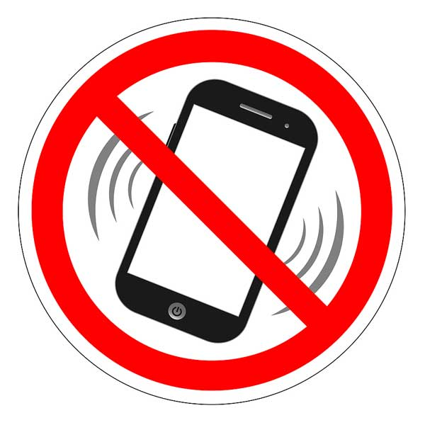
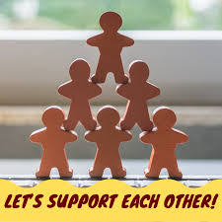


House Rules
  Confidentiality: What is said here, stays here.
  Presence: Phones away (unless on break).
  Vulnerability: We only grow when we are real.
  Support: We are here to challenge and cheer for each other.

Slide 4

Quick View…
  Your Name
  One Thing you remember from last session
  (60 Seconds Per Person)

Slide 5
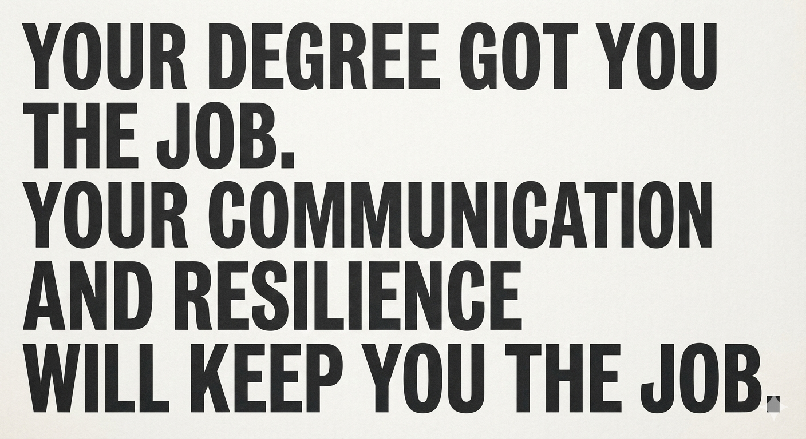

Slide 6
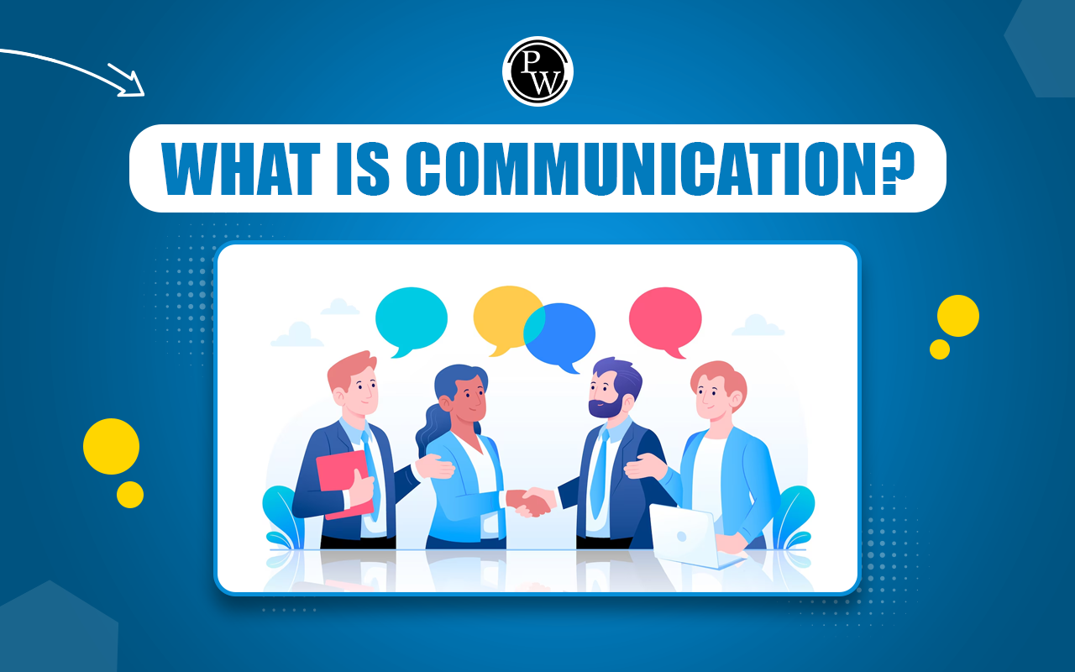
What are communication skills?
Communication skill is the ability to transfer information to another person effectively and efficiently.
It is not just about talking; it involves a complex cycle of encoding a message, transmitting it through a medium, and ensuring it is decoded (understood) by the receiver exactly as intended.

Slide 7
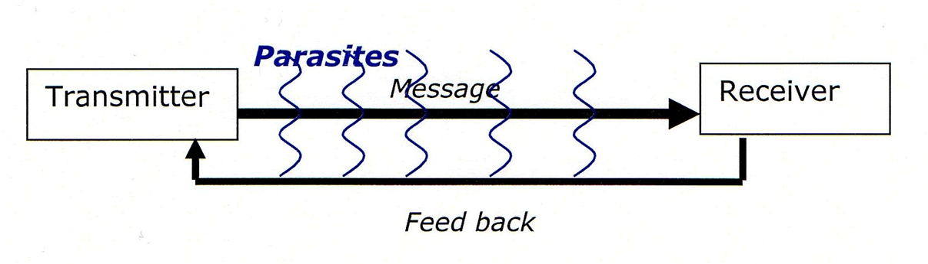
This is what is known as communication erosion
In order to communicate effectively, the essential state of mind is all about
being constantly focused on the need to be accessible in terms of communication to the audience.
checking that the receiver has understood, by asking him to reformulate for example.

Slide 8
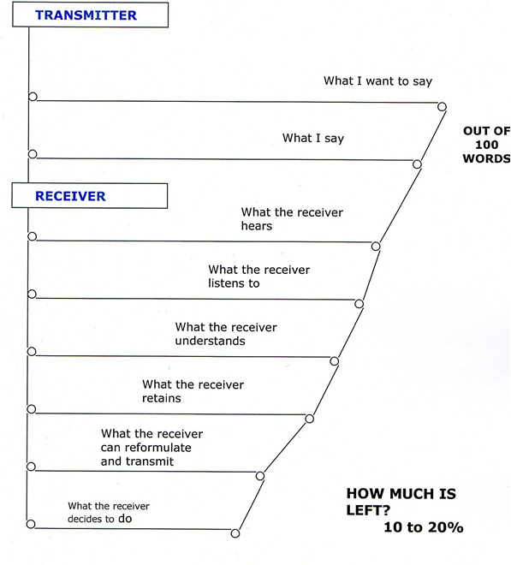
When I communicate, what counts is not what I’m saying, but what my listener has understood and retained.

Slide 9

Types of communication skills
Verbal communication: The use of words to convey messages, whether in person or through digital means.
Non-verbal communication: Includes body language, gestures, and facial expressions that complement verbal communication
Written communication: The art of communicating by writing, spanning from emails and reports to texts and social media posts.
Visual communication: The strategic use of images, graphs, charts, and other visual elements to share information.

Slide 10
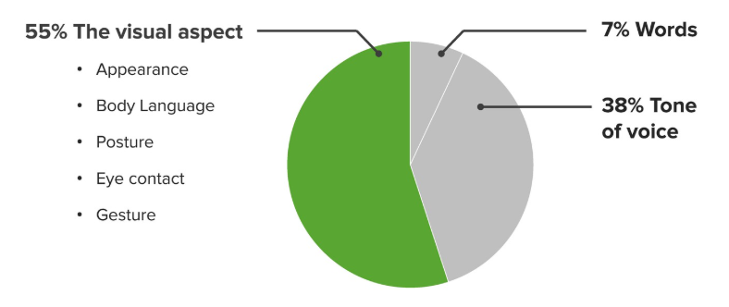
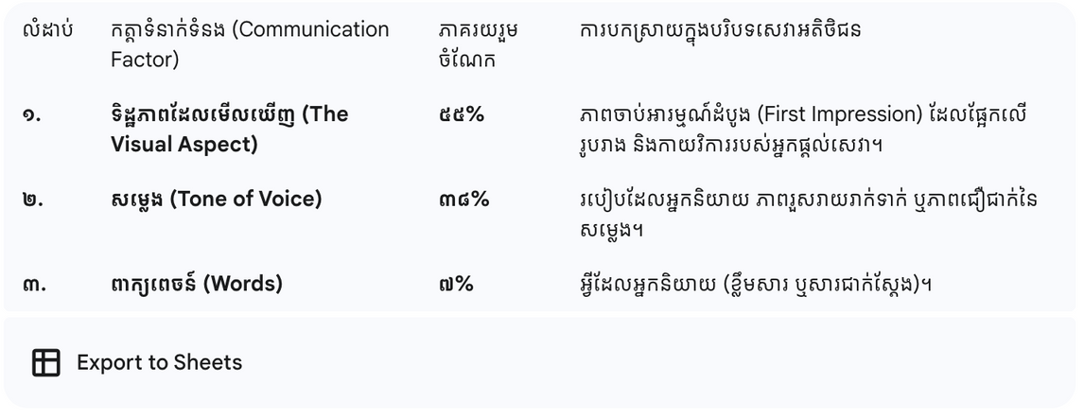
The Communication Conundrum
What you see is what you get

Slide 11
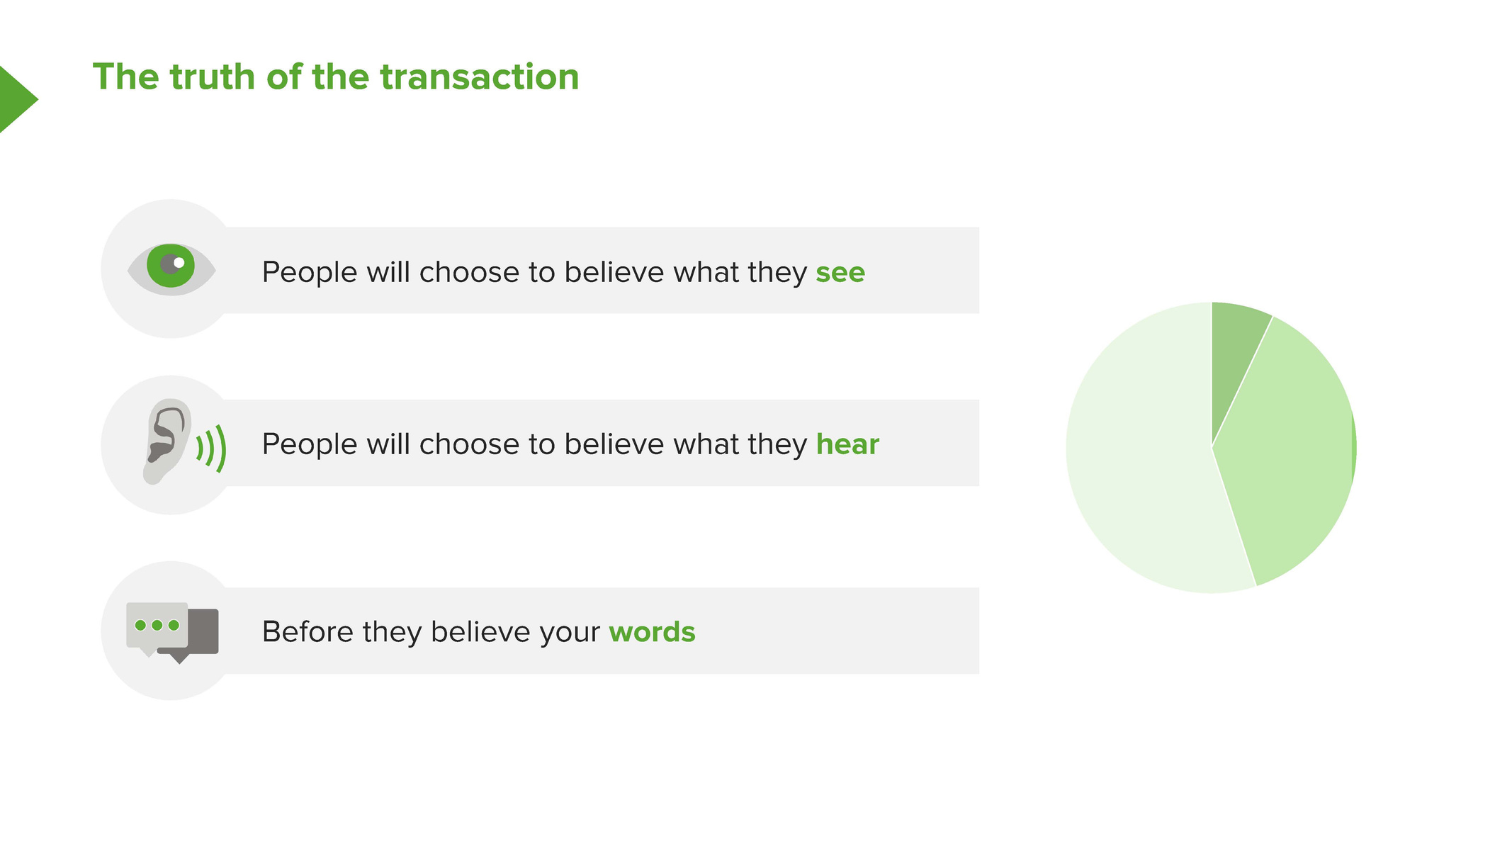

Slide 12
When Verbal and Non-Verbal Work Together
We naturally mix both types when:
Emphasizing a point (e.g., raising your hand while explaining).
Making it easier to understand, especially across language barriers.
Reinforcing meaning, gestures and tone help messages feel more genuine.
🧠 Research shows that gestures and words are connected. When we pause speaking, our gestures usually stop too.

Slide 13
Why are communication skills important?
Building strong relationships: Proficient communicators excel in building and nurturing robust professional relationships, fostering collaboration and mutual understanding.
Enhancing professional image: Great communication skills elevate how individuals are perceived within their professional circles, positioning them as reliable and competent professionals.
Cultivating reliability: Consistent and transparent communication instils trust and reliability, essential qualities for fostering successful partnerships and collaborations.
Driving engagement: Communicating effectively engages and influences the audience, amplifying their leadership potential and impact within the organization.
Enhancing performance: Clear and impactful communication enhances the effectiveness of presentations, pitches, and interactions, leading to improved outcomes and results.
Increasing collaboration: Successful teamwork hinges on clear communication, enabling seamless coordination, idea exchange, and collective problem-solving.

Slide 14

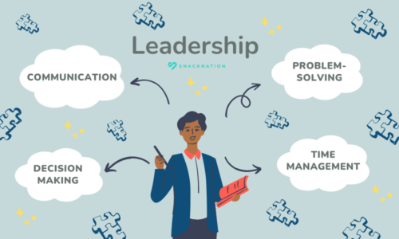
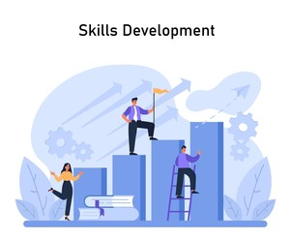


How communication skills help in career development?
Building Professional Networks
Enhancing Leadership Capabilities
Securing Stakeholder Support
Driving Collaborative Success

Slide 15
How to improve communication skills?

Slide 16

Active Listening
The Core Idea: Listen to understand, not just to respond.
Action: Give 100% focus to the speaker.
Benefit: Builds trust, demonstrates empathy, and fosters deeper connections.
Key Tip: Mirror back what you heard to ensure accuracy.

Slide 17

Public Speaking
The Core Idea: Confidence is a muscle built through practice.
Action: Seek opportunities to present or lead meetings.
Benefit: Improves verbal clarity and boosts self-assurance.
Key Tip: Focus on one clear "takeaway" for your audience.

Slide 18
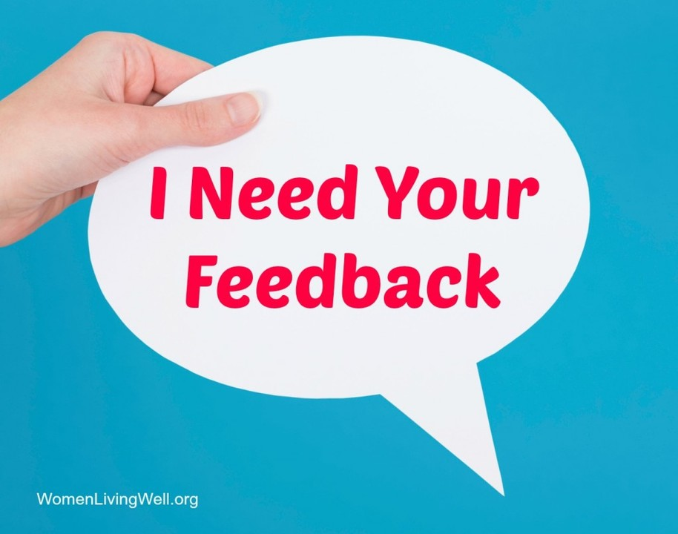
Seeking Feedback
The Core Idea: You cannot fix what you cannot see.
Action: Proactively ask colleagues: "How could I have delivered that more clearly?"
Benefit: Identifies blind spots and accelerates skill refinement.
Key Tip: Treat feedback as data, not a personal critique.

Slide 19

Adaptive Communication
The Core Idea: One size does not fit all.
Action: Tailor your tone and visual aids to your specific audience.
Benefit: Increases engagement and ensures your message is received as intended.
Key Tip: Consider the "knowledge level" of your audience before choosing your words.

Slide 20
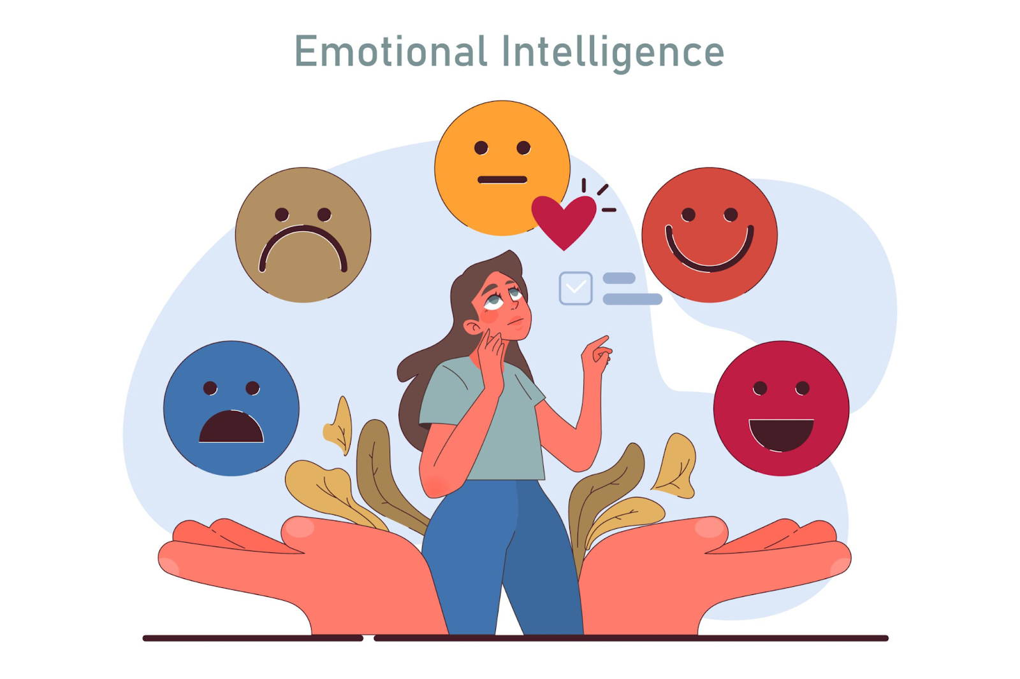
Emotional Intelligence (EQ)
The Core Idea: Manage emotions to manage the conversation.
Action: Practice self-awareness during high-pressure interactions.
Benefit: Helps navigate conflict and build stronger professional rapport.
Key Tip: Pause before responding to an emotional trigger.

Slide 21
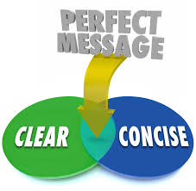
Clarity & Conciseness
The Core Idea: Less is more.
Action: Eliminate jargon and "filler" words.
Benefit: Minimizes misunderstandings and respects everyone’s time.
Key Tip: If you can say it in 5 words, don't use 10.

Slide 22

Professional Development
The Core Idea: Continuous improvement through structure.
Action: Enroll in communication workshops or specialized training.
Benefit: Provides a systematic toolkit of proven techniques.
Next Step: Commit to one new communication habit this month.

Slide 23


Slide 24
What is Resilience?
Resilience is the ability to bounce back, adapt, and keep going when things go wrong.
Ask:
“When was the last time you bounced back from a challenge?”

Slide 25
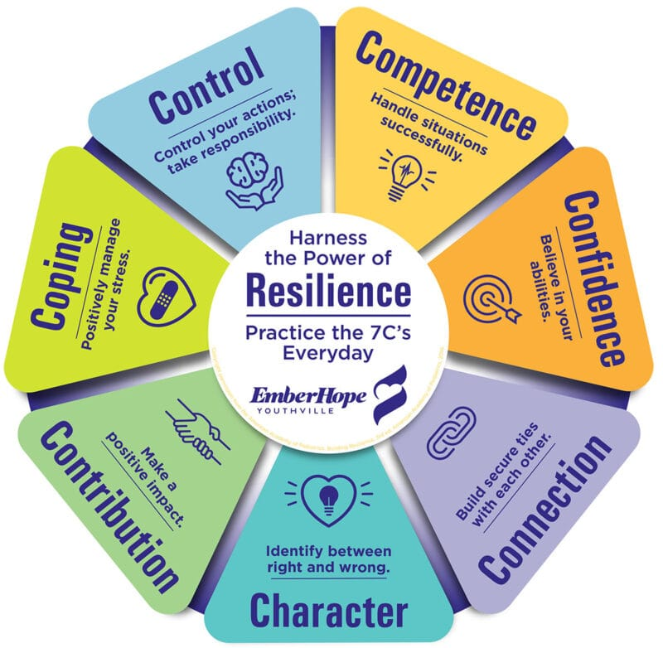
The 7Cs Overview

Slide 26

1. Competence
Meaning:
Identifying your strengths and being able to apply them while also recognizing where you need to grow.
Why it matters:
When you understand your own strengths,
you make faster decisions. When you know your weak areas, you can fill the gap before it becomes a risk.
Example:
You realize you are very strong at technical research but struggle with public speaking.
=> To fill this gap before it becomes a professional risk, you volunteer to lead a small team meeting or take a short course on professional communication.

Slide 27

2. Confidence
Meaning:
Trusting your ability to handle new or difficult situations because you have successfully navigated hard things in the past.
Why it matters:
Everyone face unfamiliar problems all the time. Confidence helps you stay calm, take action, and move forward.
Example:
You are assigned a complex project at your first job that feels overwhelming.
=> ou remind yourself how you successfully completed a difficult 50-page thesis or passed a high-pressure exam.

Slide 28

3. Connection
Meaning:
Identifying people you can rely on for support, such as mentors, former professors, and peers
Why it matters:
Strong connections give you quick advice, emotional support, and sometimes even new opportunities.
Example:
You feel "stuck" or confused by the corporate culture at your new workplace.
=> You reach out to a senior colleague for a "coffee chat" or contact a university mentor to ask for advice on navigating professional relationships.

Slide 29
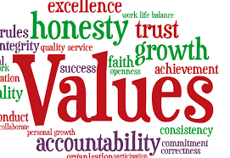
4. Character
Meaning:
Your core values and principles that you refuse to compromise, even when work is stressful.
Why it matters:
Values guide hard decisions, protect your reputation, and help you stay consistent as a leader.
Example:
You are asked by a peer to take credit for work you didn't do to meet a deadline.
=> Because your value is "honesty and integrity," you choose to be transparent about your progress instead. This builds long-term trust with your manager and protects your reputation early in your career.

Slide 30
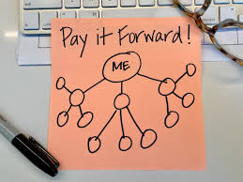
5. Contribution
Meaning:
Finding a purpose for your work that goes beyond just earning a salary.
Why it matters:
When work is slow or stressful, your purpose keeps you motivated and focused.
Example:
Your entry-level tasks feel repetitive or unimportant.
=> You remind yourself that by doing your job well, you are helping your company provide better services to the Cambodian community. This sense of purpose keeps you motivated during slow or stressful days.

Slide 31
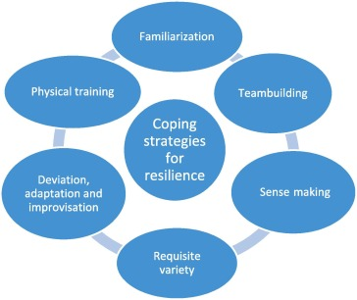
6. Coping
Meaning:
Managing the mental and physical stress of the “12 hours shifts or 9-5" life to avoid burnout.
Why it matters:
If you burns out, the entire work and life suffers. Coping habits protect your energy and decision-making.
Example:
You feel exhausted by the sudden change from a flexible student schedule to a full-time work week.
=> You establish a habit of getting enough sleep, taking short breaks away from your screen during the day, and engaging in a hobby after work to clear your mind.

Slide 32
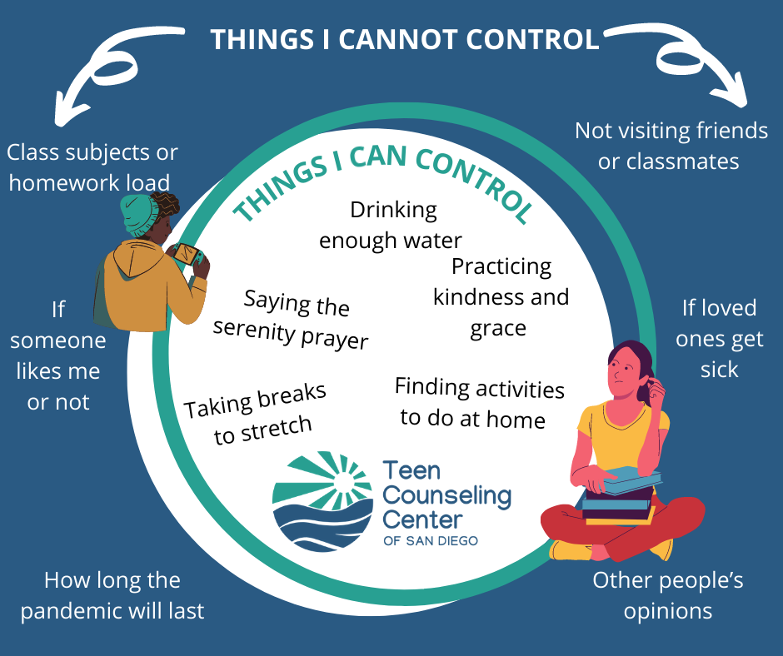
7. Control
Meaning:
Focusing your energy on what you can change rather than worrying about things outside your power.
Why it matters:
Worrying about things outside your control drains your energy and slows down your decisions.
Example:
You are worried about the competitive job market or a change in company leadership.
=> You can't control the economy, but you can control how much you prepare for your next performance review, the quality of your daily output, and how professionally you treat your teammates.

Slide 33

Thank you
For your active participating and congratulation.

