Slide 1
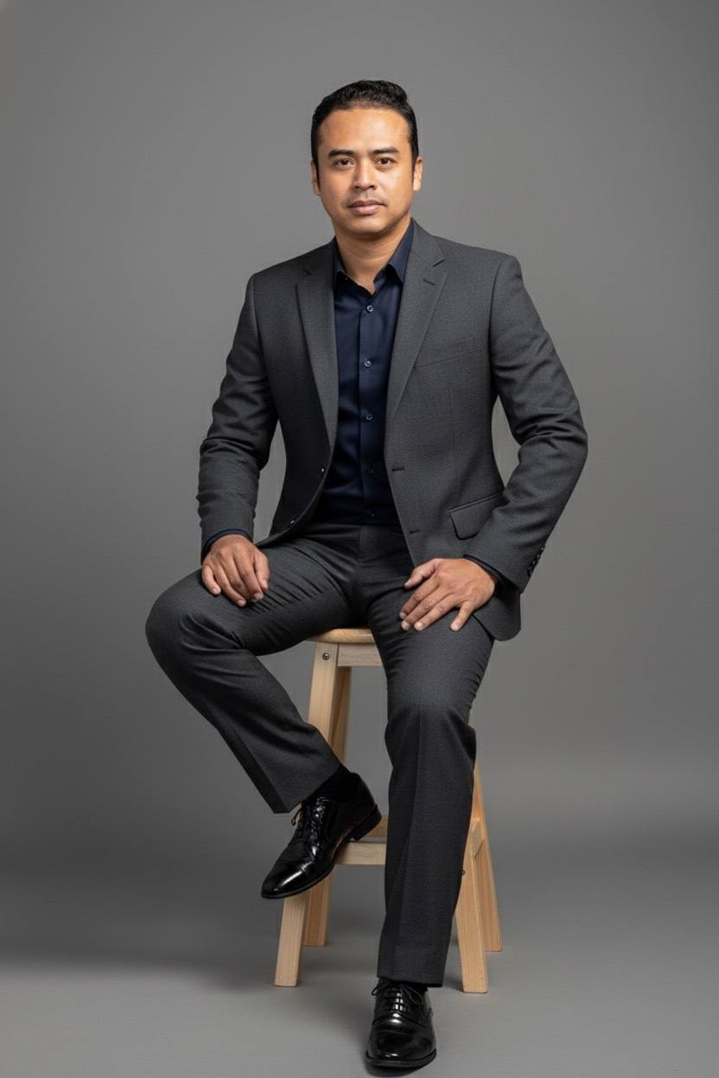
7 KEY COMPONENTS
THAT ARE ESSENTIAL FOR DEVELOPING AN ORGANIZATION GEARED FOR LONG-TERM SUCCESS!
Presented by Mr. Chivin DOUNG,
Co-Founder, Managing Director
Ph.D Candi, Coach, Mentor, Biz Consultant

Slide 2

1. Clear Vision and Mission
Define a compelling vision that outlines where the organization is headed.
Establish a mission statement that communicates the organization's purpose and the value it provides to stakeholders.
Align goals and strategies to this vision and mission consistently.

Slide 3

2. Strong Leadership
Cultivate leaders who inspire, motivate, and empower their teams.
Leadership should model the organization's values, drive innovation, and make strategic decisions that foster growth.
Encourage leadership development across all levels, not just at the top.

Slide 4
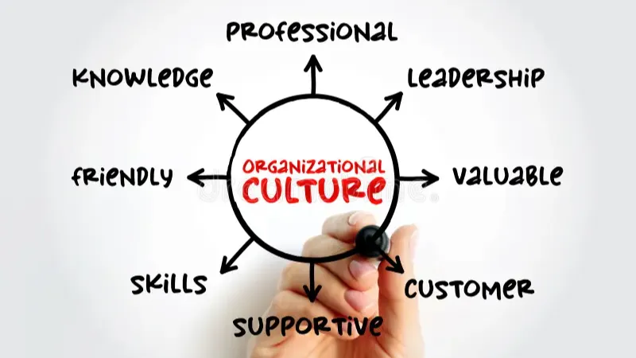
3. Organizational Culture and Values
Develop a positive and inclusive culture rooted in shared values and ethical practices.
Promote trust, accountability, and collaboration among employees.
Recognize and reward behaviors aligned with company values to strengthen the culture.

Slide 5

4. Strategic Planning and Execution
Create a clear strategy with measurable goals that align with market trends and organizational strengths.
Implement robust systems to monitor progress and adapt when circumstances change.
Encourage innovation and agility to stay competitive.

Slide 6

5. Talent Management and Development
Attract, retain, and develop skilled employees who align with the organization’s mission and culture.
Provide opportunities for training, career advancement, and continuous learning.
Build strong performance management systems to ensure accountability and growth.

Slide 7
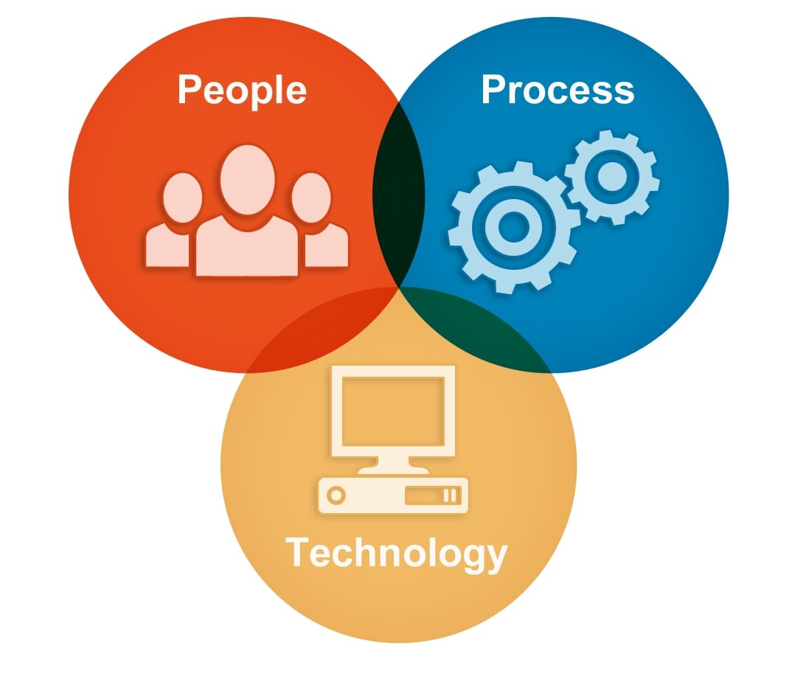
6. Operational Excellence and Technology
Develop efficient processes and systems that optimize resources and reduce waste.
Leverage technology and data analytics to improve decision-making and enhance customer experience.
Maintain quality control and continuous improvement practices.

Slide 8
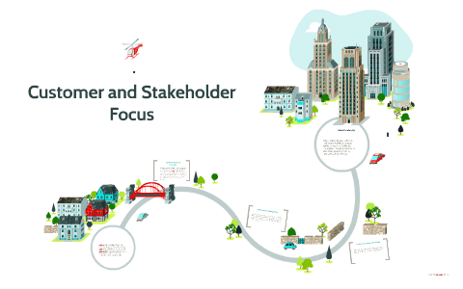
7. Customer and Stakeholder Focus
Understand and prioritize the needs of customers, clients, and stakeholders.
Build long-term relationships based on trust, transparency, and value creation.
Actively seek feedback to improve products, services, and overall customer experience.

Slide 9

Thank You

