Slide 1



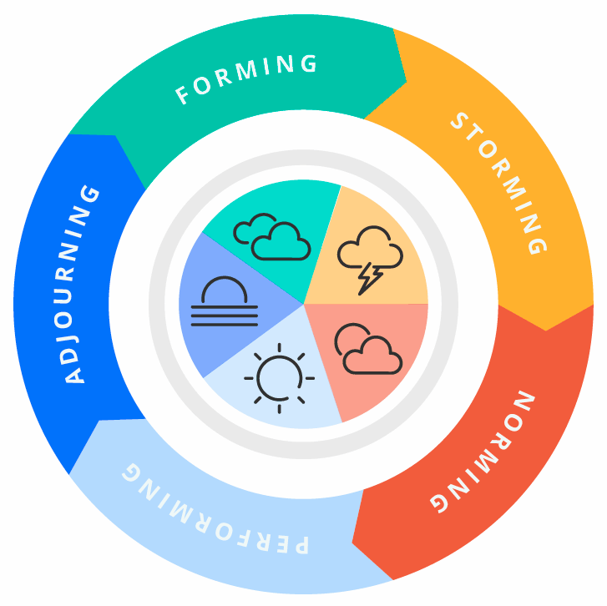


Five Stages of Team Development
Prepared by : Mr. Chivin DOUNG
Co-Founder & GM @ Elevate Solution Partners
Ph.D Candi, Coach, Mentor, Consultant
Date : August 2025

Slide 2

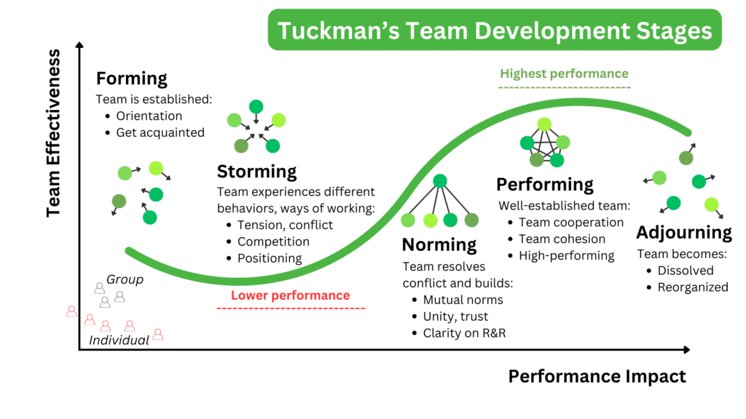

Slide 3
FORMING
Time management is the process of planning and controlling how you spend your time on specific tasks and activities. It’s about organizing your day in a way that helps you be more productive, focused, and less stressed, making sure the most important work gets done, not just the urgent.
It includes skills like:
  Setting priorities
  Scheduling tasks
  Avoiding distractions
  Meeting deadlines
  Balancing workload and rest

Slide 4

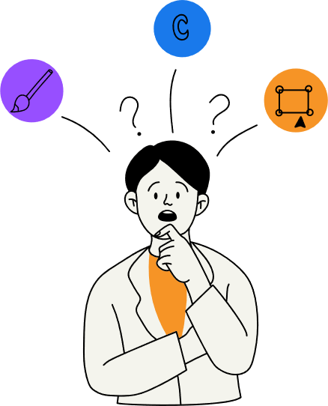
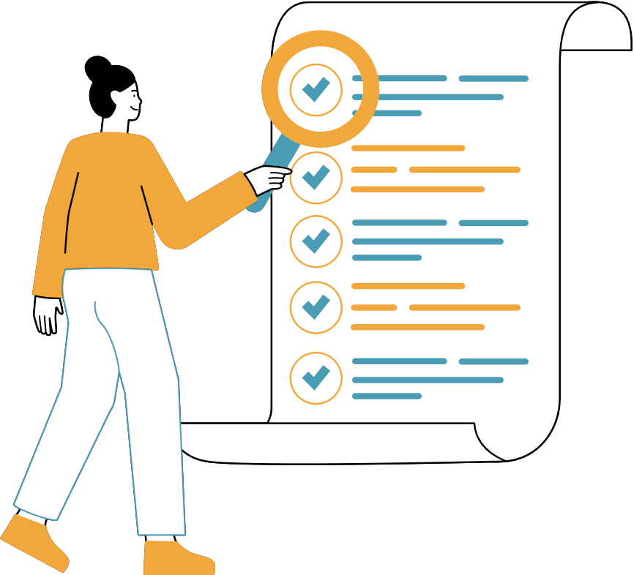
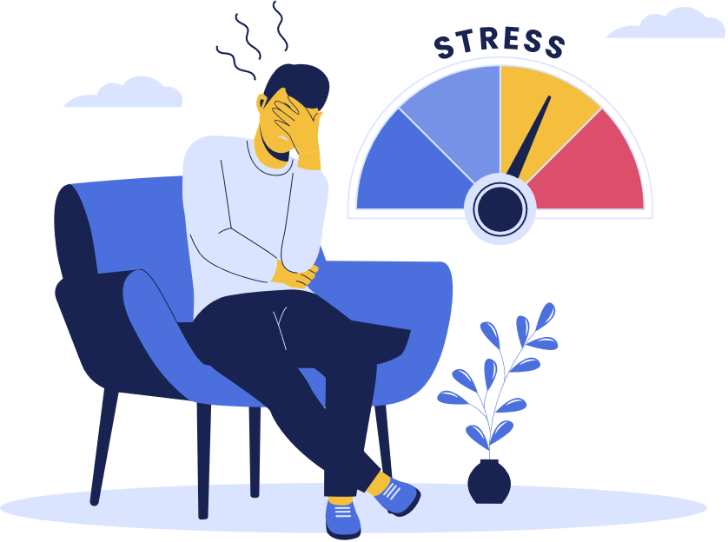
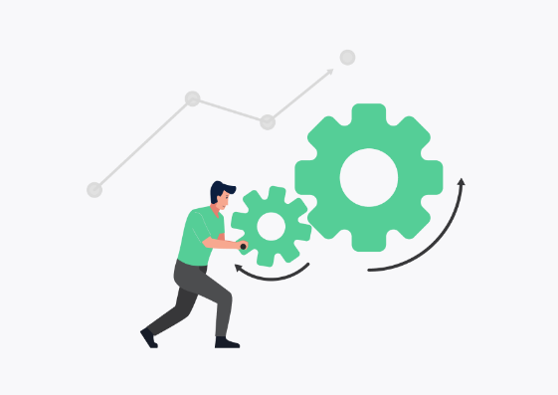


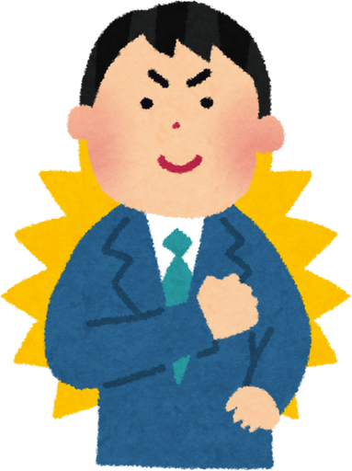
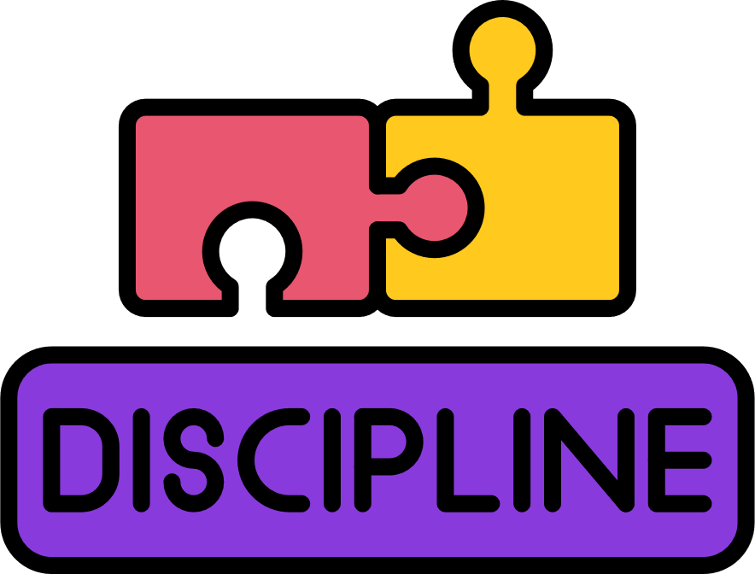


WHY IMPORTANT?
High Productivity
Improved Decision-Making
Helps You Prioritize
Reduces Stress
Improves Work Quality
You get more done in less time when your schedule is structured.
You focus on what’s truly important, not just what’s urgent.
A clear plan reduces last-minute pressure and anxiety.
When your mind is clear, it’s easier to make smart choices.
More time = more focus = fewer mistakes.
Boosts Confidence
Builds Self-Discipline
Supports Goal Achievement
No More Missed Deadlines
Staying on track and meeting deadlines makes you feel capable.
Being focus and accountable with your tasks.
You move consistently toward long-term goals, not just daily tasks.
You stay ahead of schedule and deliver on time, consistently.

Slide 5
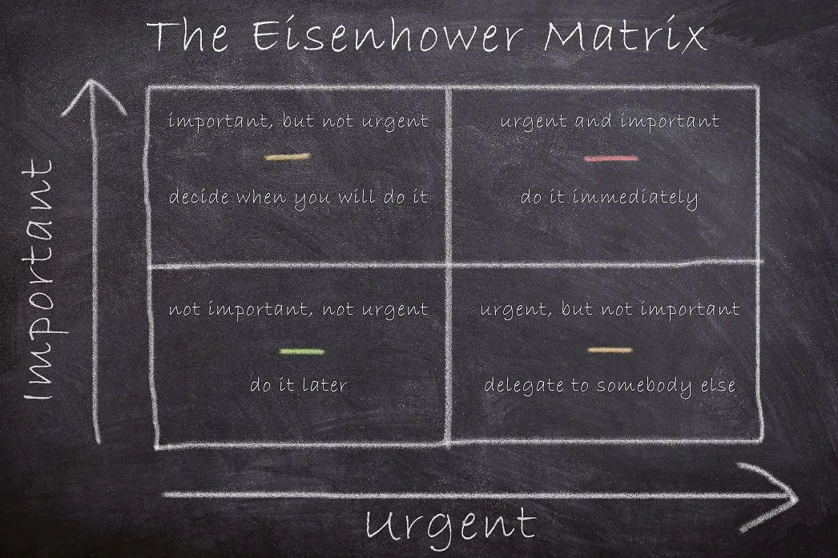


TOOLS
Eisenhower Matrix
Pros of the Eisenhower Matrix
  Clear Prioritization
  Improves Decision-Making
  Reduces Overwhelm
  Promotes Strategic Thinking
  Easy to Use and Visual
Cons of the Eisenhower Matrix
  Requires Good Judgement
  Not Always Flexible
  Overlooks Task Complexity
  Can Lead to Over-Scheduling
  Needs Regular Review

Slide 6
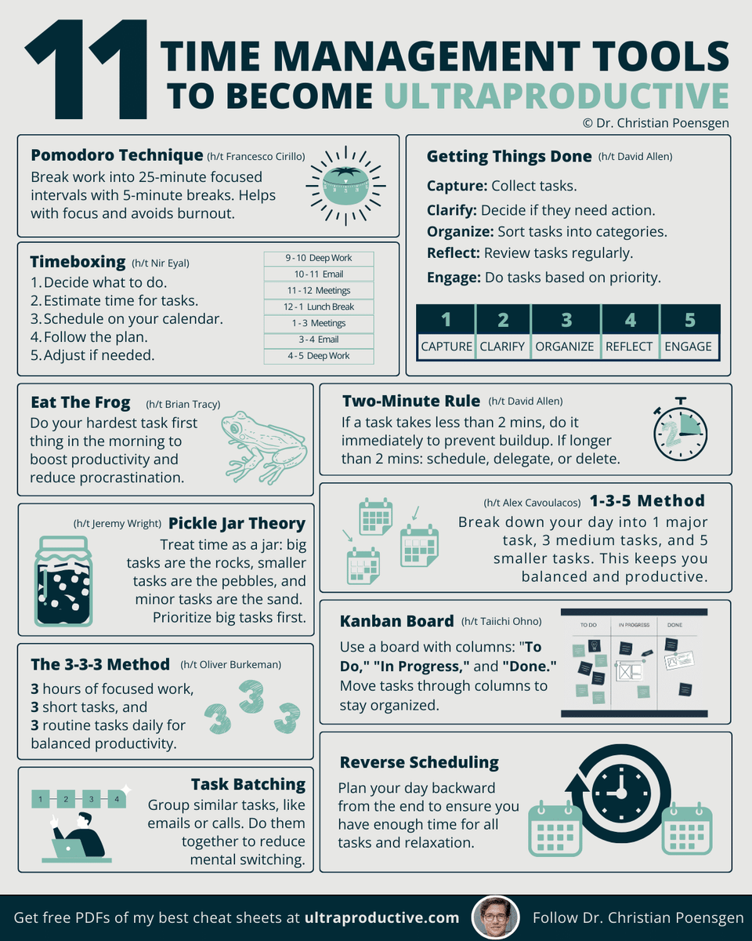
TOOLS

Slide 7

TOOLS
WHICH ONE?

Slide 8

WHY IT DOESN'T WORK?

Slide 9
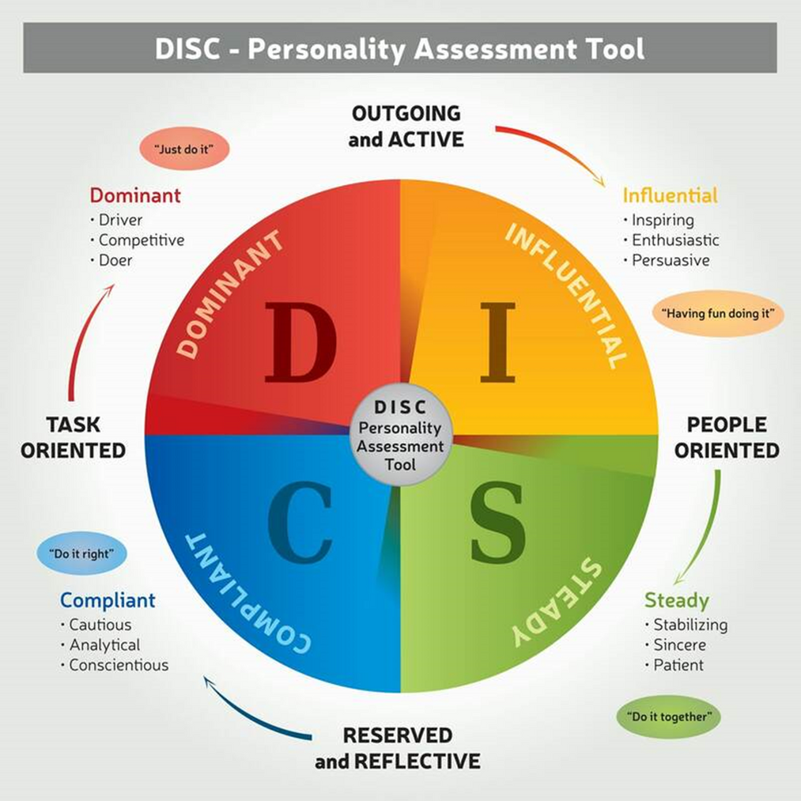
KNOW YOURSELF, CHOOSE YOUR METHOD

Slide 10
KNOW YOURSELF, CHOOSE YOUR METHOD

Slide 11

WHAT WORK BEST
D – Dominance
Focus on: Outcomes and deadlines
Tips:
  Use time blocking to control the day and avoid distractions.
  Identify top 3 priorities daily — avoid overloading with non-essential tasks.
  Set short, measurable goals with clear deadlines.
  Delegate tasks that slow you down.

Slide 12

WHAT WORK BEST
I – Influence
Focus on: Visual and interactive systems
Tips:
  Use visual planners (whiteboards, colorful apps).
  Break tasks into short, exciting sprints (Pomodoro works well).
  Schedule buffer times for creative breaks or conversations.
  Use reminders and accountability partners to stay on track.

Slide 13

WHAT WORK BEST
S – Steadiness
Focus on: Routines and predictability
Tips:
  Create a daily and weekly schedule to reduce stress.
  Build in transition time between tasks to reduce overload.
  Use checklists to track progress without overwhelm.
  Practice saying “no” or “not now” to protect time.

Slide 14
WHAT WORK BEST
C – Compliant
Focus on: Accuracy and planning
Tips:
  Set clear criteria for “done” — avoid perfection paralysis.
  Use time estimations to avoid over-planning.
  Prioritize tasks using Eisenhower Matrix or ABC method.
  Schedule review time at the end of day to adjust plans.

Slide 15

THANK YOU?

