Slide 1

“ The 5 P’s ” of
Effective Leadership
Practical Approach for Team Performance
Chivin DOUNG
MD & Lead Coach Elevate Solution Partners
Ph.D Candi, Lead Coach, Trainer, Coach

Slide 2

1. P – Purpose
Purpose is the “North Star" of leadership, providing the ultimate reason for the organization's existence.
A strong purpose is the foundation. It clearly defines the mission, vision, and values, which inspires employees to rally around a shared goal.
Communicate the Vision: Use storytelling and real-world examples to bring the purpose to life for your team.
A sense of purpose motivates and engages team members, helping them to persevere through challenges.

Slide 3

2. P – Plan
A plan serves as the strategic roadmap for turning the vision into a reality.
The plan should be actionable and measurable.
Leadership involves guiding the organization through the strategic planning process, ensuring that goals are realistic and that the necessary resources are allocated effectively.
Effective leaders also plan for employee development, creating personalized roadmaps to help team members acquire new skills and grow their careers.

Slide 4

3. P – People
People are the heart of leadership, as a leader's success depends on their ability to build relationships, nurture collaboration, and empower their team.
Empowering and motivating others is a key trait of effective leaders.
Empathetic and compassionate leaders take the time to understand their team members' perspectives, emotions, and needs, nurturing a more supportive and inclusive environment.
Building strong bonds among team members creates a healthy, productive workplace and inspires loyalty.

Slide 5

4. P – Process
The repeatable systems and structures that ensure consistency and make progress sustainable.
Effective leaders establish clear processes that define how work gets done and create accountability. This helps teams work efficiently and stay focused on objectives.
Defining roles and responsibilities, creating clear workflows, and establishing routines for communication and problem-solving.
The right processes provide a framework that allows the team to operate smoothly, enabling the leader to focus on strategy and inspiration rather than day-to-day firefighting.

Slide 6

4. P – Performance
Driving results and measuring progress to hold the team and yourself accountable for outcomes.
This is a data-driven approach. Effective leaders use key metrics and performance indicators to evaluate progress and make informed decisions.
Performance-driven leaders also balance high expectations with employee well-being.
Celebrating wins and learning from setbacks are crucial parts of managing performance, helping to reinforce a culture of continuous improvement.

Slide 7
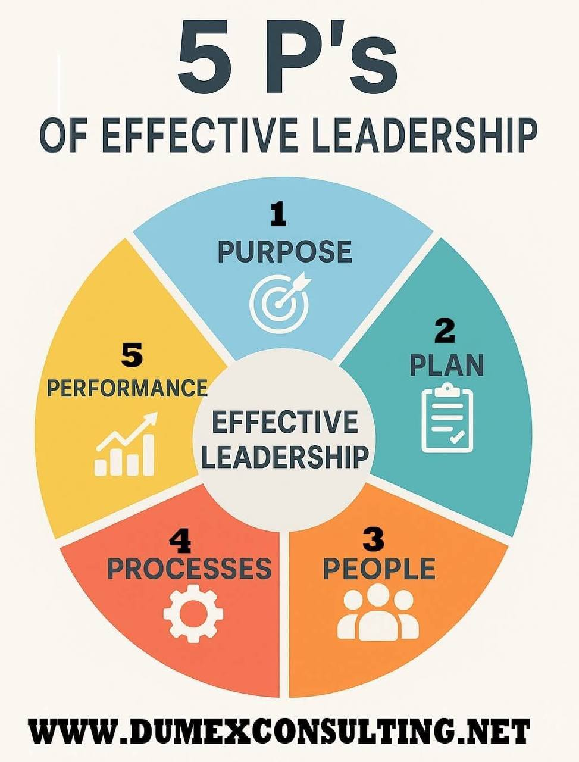

Slide 8

Thank You

